Slide 1

Health Apartment Working Group
Prototype Phase
OCTO and OCC | January 5, 2022
Notes:
Meg

Slide 2

Agenda
INTRODUCTION
Project and team introduction
PoC definition and timeline
Sitemap
Homepage designs
During presentation we will pause for Q&A we also invite our guests to sign into our mural to add comments as we go.
Health Apartment Working Group | January 5, 2022

Slide 3
Project and Team Introduction

Slide 4
Vision
HEALTH APARTMENT
To simplify and unify the Veteran digital health experience by creating an accessible, usable, and discoverable health “apartment” on VA.gov.
This will give Veterans a single place to accomplish all of their key health related tasks.
To learn historical context on how we got here.
Health Apartment Working Group | January 5, 2022

Slide 5


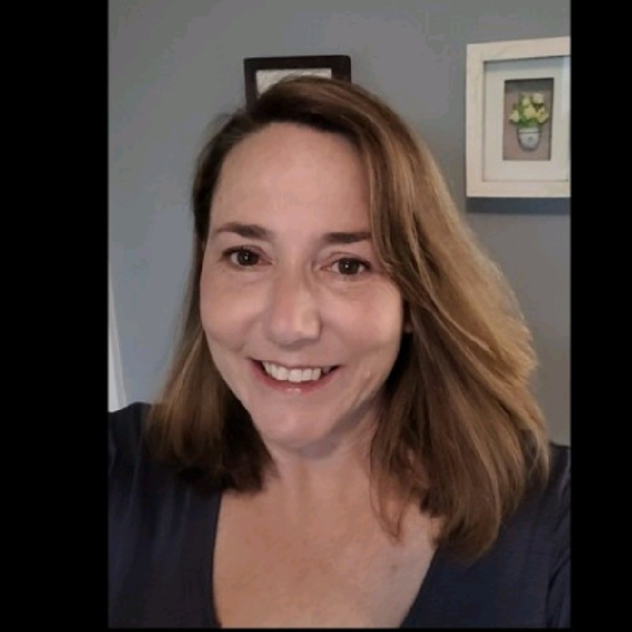





Health Apartment Team
HEALTH APARTMENT
OCTO Leadership Team
Charles Worthington (CTO) Chris Johnston (Product Line Manager) Jeff Barnes (Dep. Product Line Manager) Lauren Alexanderson (Dep. CTO, Health Delivery)
Core Team
Jordan White Product Manager,
MO Studio
Tracey Mulrooney Product Owner, OCTO
OCC Leadership Team
Kathy Frisbee (Acting Head, Office of Connected Care) Nancy Wilck (Director, Digital Health) Theresa Hancock (Director, My HealtheVet)
Tami Corson
CSM, Clinical SME,
SERVE Advisory Group
Meg Peters Design Lead, OCTO
Jesse Singh UX Design Lead,
MO Studio
Jared Cooke Front-End Engineer, MO Studio
Extended Team Partners
OCC / My HealtheVet teams OCTO teams working on health-related and sitewide things
Carl Dickerson
Content Strategy
MO Studio
Nadya Primak Front-End Engineer, MO Studio
Health Apartment Working Group | January 5, 2022

Slide 6
PoC Definition and Timeline

Slide 7
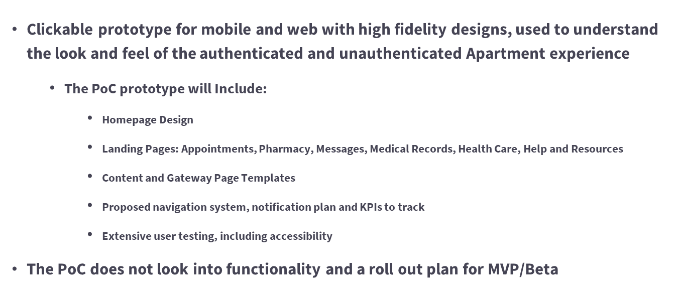
PoC Definition
THE JOURNEY TO POC
Health Apartment Working Group | January 5, 2022

Slide 8
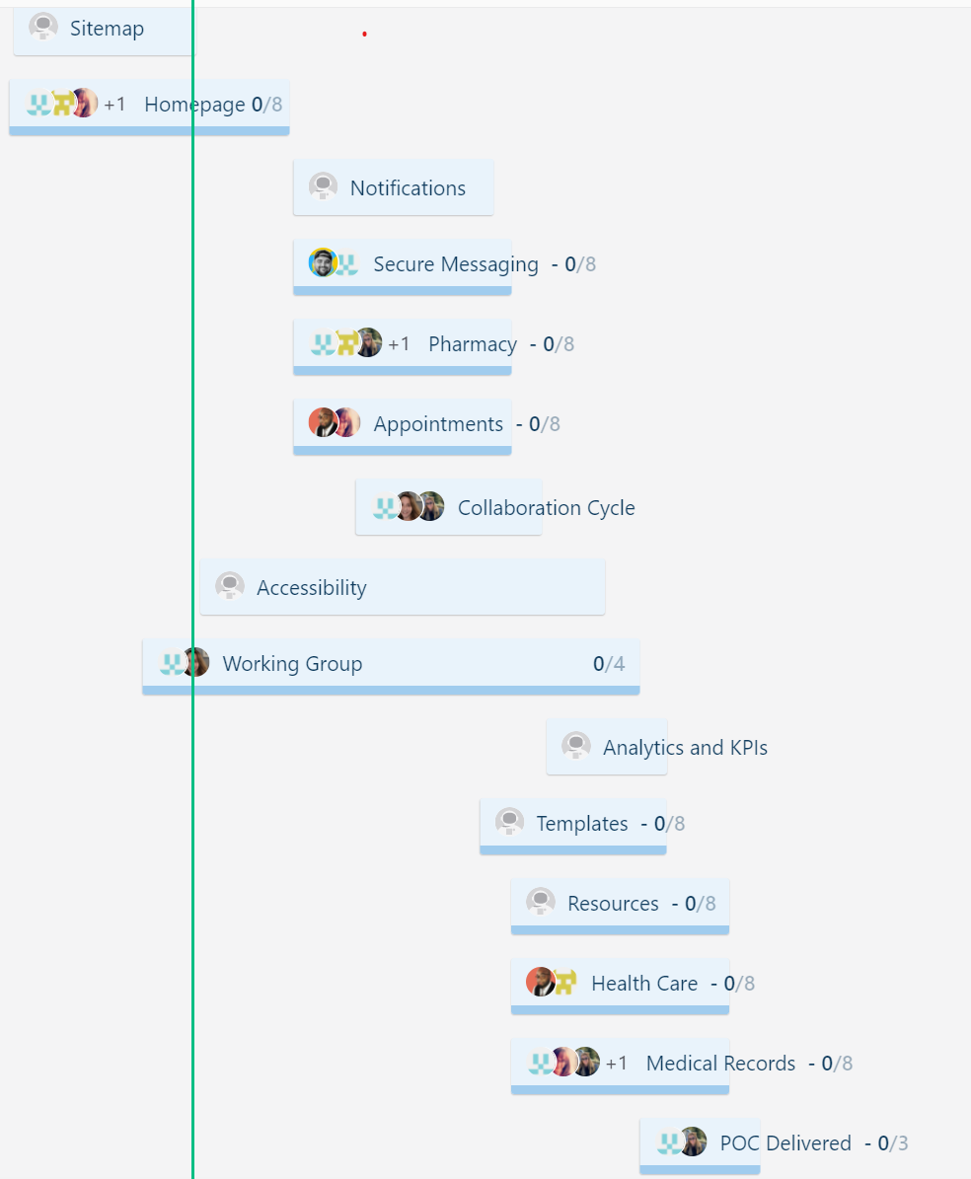
PoC Timeline
THE JOURNEY TO POC
New roadmap in ZenHub
Health Apartment Working Group | January 5, 2022

Slide 9
Sitemap and Design

Slide 10
Sitemap and Design
WHERE WE ARE
Please follow this link to the Mural
We invite all stakeholders to follow along with us to see the work
This will be interactive, so we welcome any and all feedback
The team will capture these insights for future design progression
Stakeholders are also welcome to comment on the mural using the sticky note function throughout the presentation or at your convenience until tomorrow at 1200 ET.
Health Apartment Working Group | January 5, 2022

Slide 11
Thank you!
Have questions? Want to discuss something?
Reach out to meg.peters@va.gov.

Slide 12
Appendix

Slide 13
Mission
HEALTH APARTMENT
The Health Apartment Team’s mission is to simplify Veterans’ health experience on the web, picking up where the DHM Team left off. The original DHM Team has fulfilled its mission and our goal is to build on the great work of MHV. Going forward, work on the health apartment will be one of many digital health modernization efforts.
To get the health care they need, Veterans must find, register for, and learn to use a number of different websites and software products. Our generative research from late 2020 shows that Veterans find it extremely difficult to navigate commonplace interactions with VA health care. The VA ecosystem is so complex that Veterans feel discouraged to apply for, manage, and maximize their benefits.
Consider booking a doctor’s appointment: One system locates nearby facilities. Another schedules appointments. Another handles follow-ups like messages and prescriptions. And another reimburses travel expenses. That’s a lot for Veterans to learn. It’s also difficult for VA staff to support so many siloed systems.
We aim to reduce the number of websites, products, and interfaces (i.e., friction points) Veterans must use in order to get health care and manage their health — and we aim to make those experiences easy and intuitive.
Health Apartment Working Group | January 5, 2022

Slide 14
Acronyms
APPENDIX
DHM – Digital Health Modernization (team in OCTO that paved the way for the health apartment work)
MHV – My HealtheVet
OCTO – Office of the Chief Technology Officer
POC – proof of concept
VFS – Veteran-Facing Services
Health Apartment Working Group | October 27, 2021

